Slide 1

California School Climate, Health, and Learning Surveys (CalSCHLS): Progress Update
November 5, 2020
Note: The research reported here was supported by the Institute of Education Sciences, U.S. Department of Education, through Grant R305E150006 to the Regents of the University of California. The opinions expressed are those of the authors alone and do not represent views of the Institute or the U.S. Department of Education, or of the agencies providing data.

Slide 2
Elementary Dataset Diagnostics
Survey response rates for each grade
Difference in percentage of students by sex in each grade between survey sample and enrollment sample

Slide 3
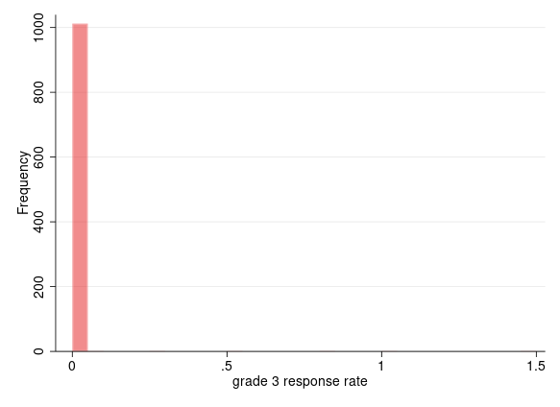
Survey Response Rate: Elementary 14-15

Slide 4
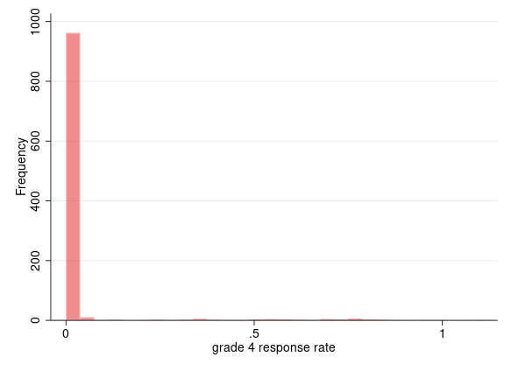
Survey Response Rate: Elementary 14-15

Slide 5
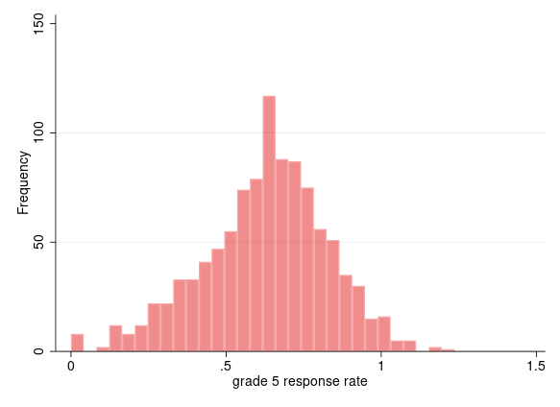
Survey Response Rate: Elementary 14-15

Slide 6
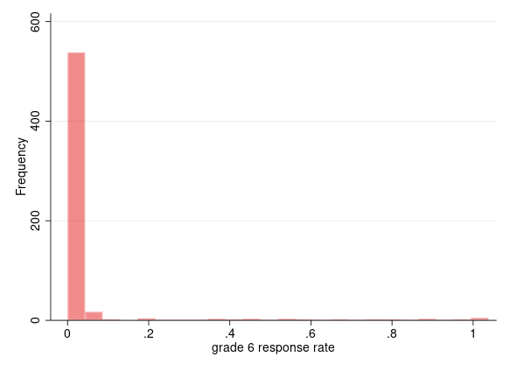
Survey Response Rate: Elementary 14-15

Slide 7
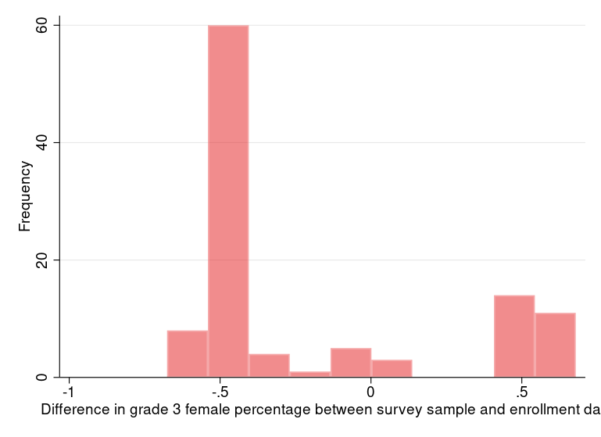
Difference in Percent of Students by Sex between Survey and Enrollment: Elementary 14-15

Slide 8
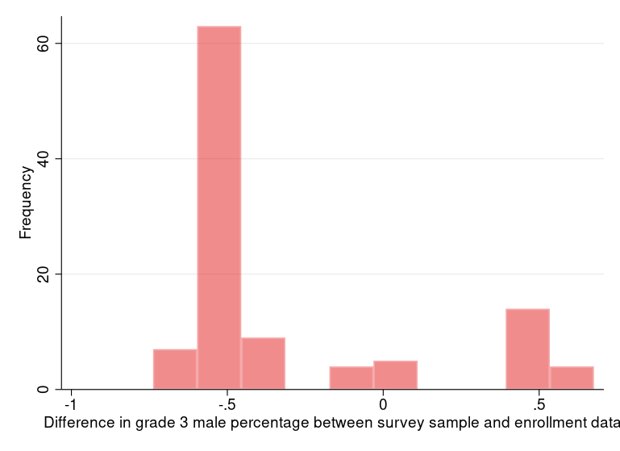
Difference in Percent of Students by Sex between Survey and Enrollment: Elementary 14-15

Slide 9
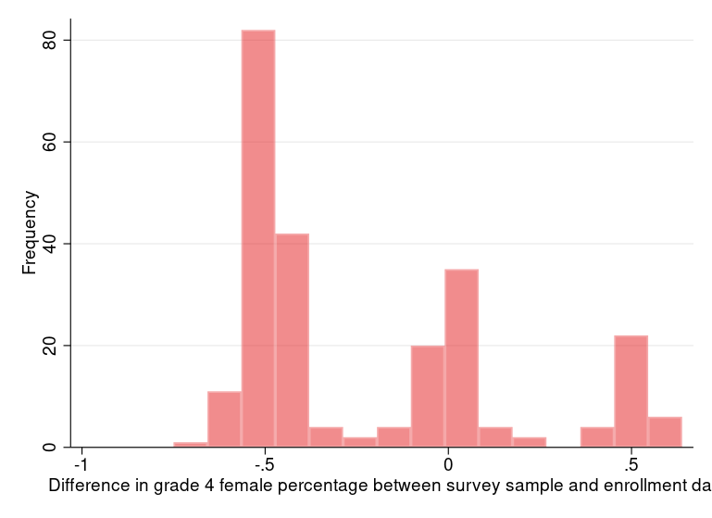
Difference in Percent of Students by Sex between Survey and Enrollment: Elementary 14-15

Slide 10
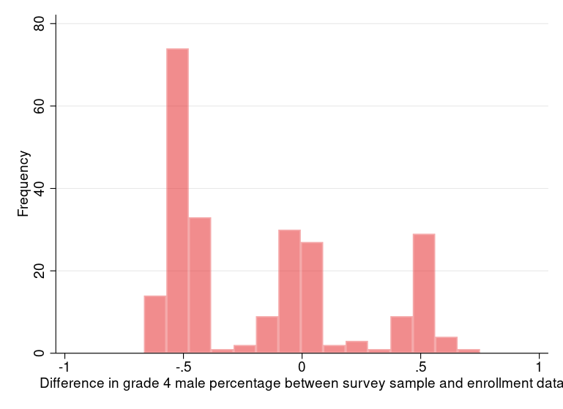
Difference in Percent of Students by Sex between Survey and Enrollment: Elementary 14-15

Slide 11
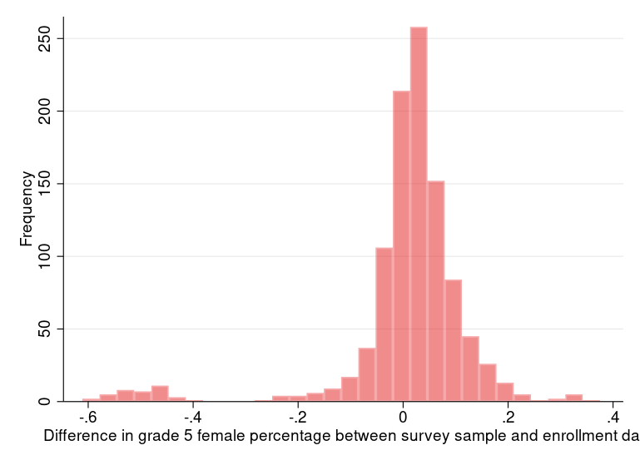
Difference in Percent of Students by Sex between Survey and Enrollment: Elementary 14-15
Female in survey grade 5/all responses in survey grade 5 – female in grade 5 enrollment/grade 5 enrollment

Slide 12
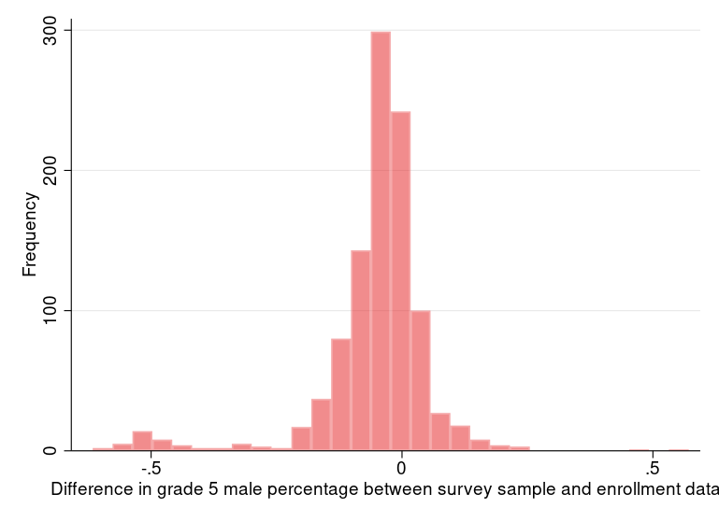
Difference in Percent of Students by Sex between Survey and Enrollment: Elementary 14-15

Slide 13
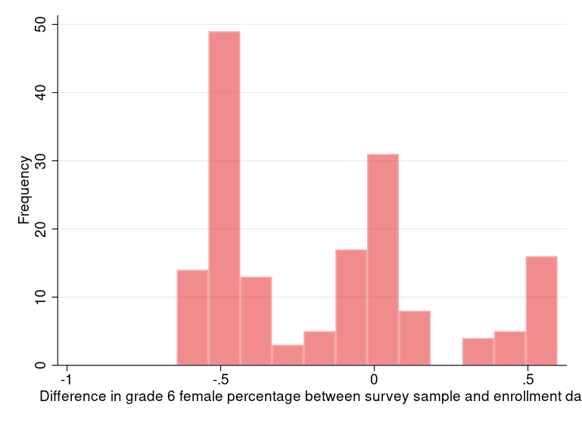
Difference in Percent of Students by Sex between Survey and Enrollment: Elementary 14-15

Slide 14
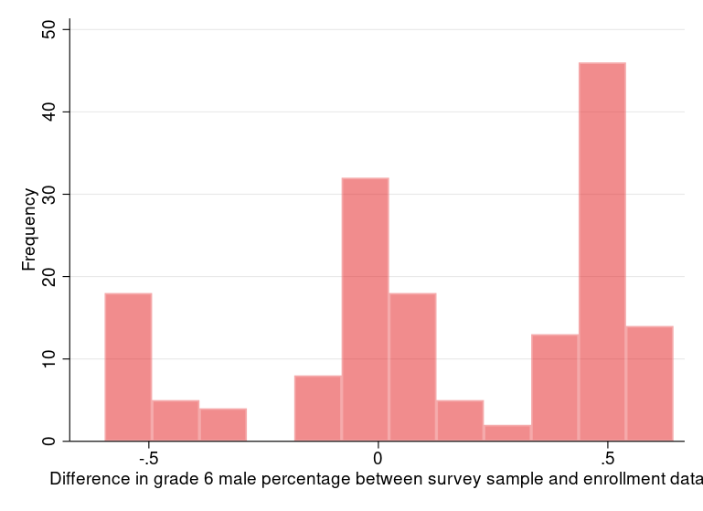
Difference in Percent of Students by Sex between Survey and Enrollment: Elementary 14-15

Slide 15
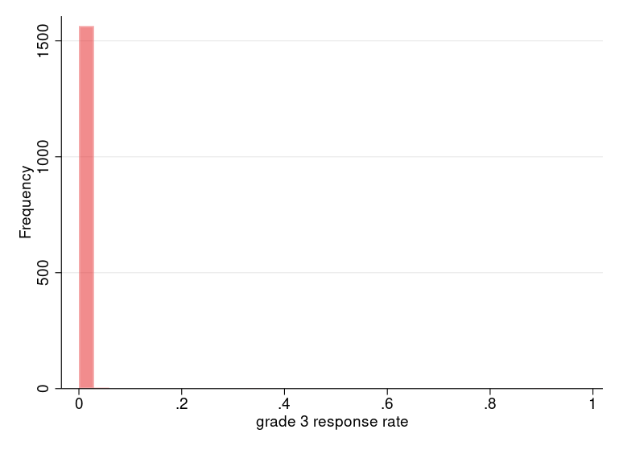
Survey Response Rate: Elementary 15-16

Slide 16
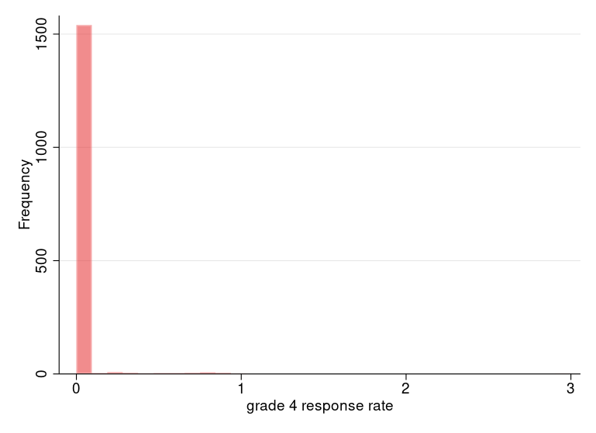
Survey Response Rate: Elementary 15-16

Slide 17
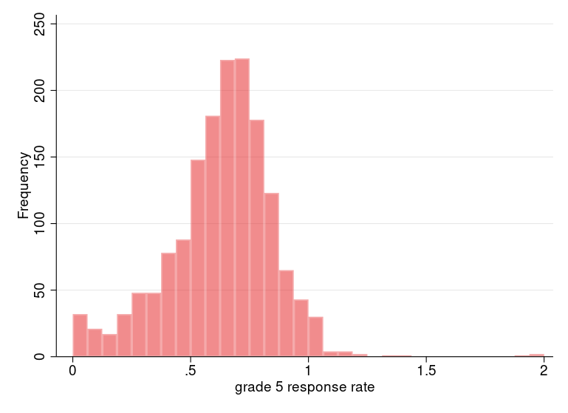
Survey Response Rate: Elementary 15-16

Slide 18
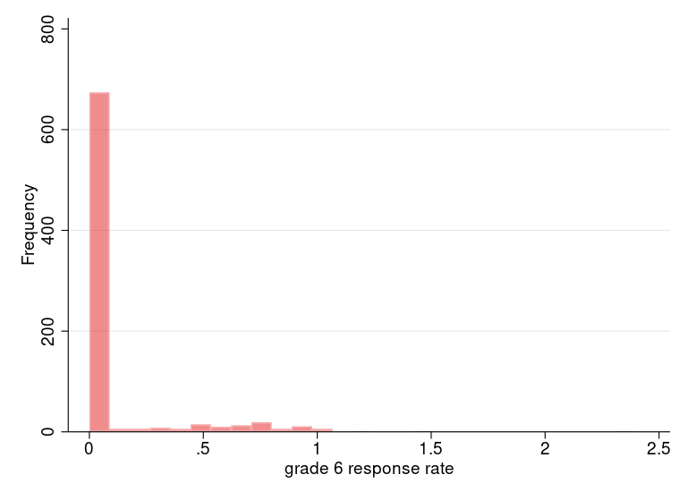
Survey Response Rate: Elementary 15-16

Slide 19
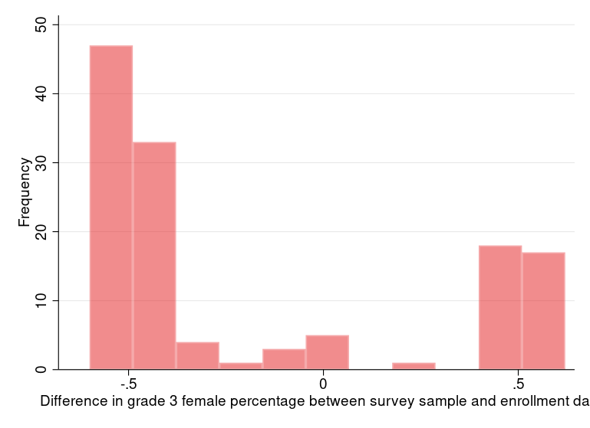
Survey Response Rate: Elementary 15-16

Slide 20
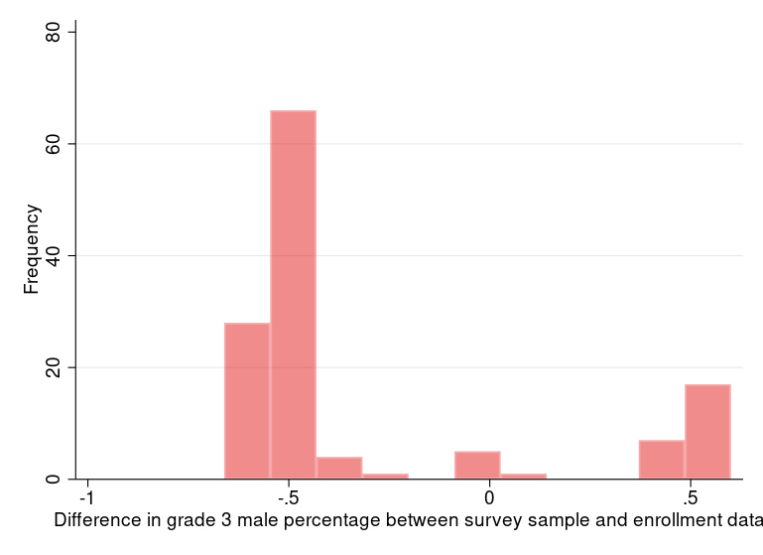
Difference in Percent of Students by Sex between Survey and Enrollment: Elementary 15-16

Slide 21
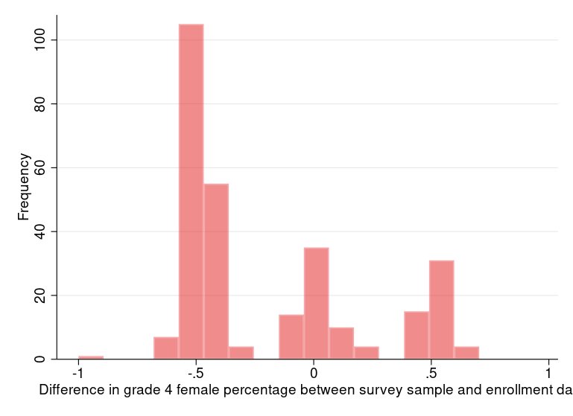
Difference in Percent of Students by Sex between Survey and Enrollment: Elementary 15-16

Slide 22
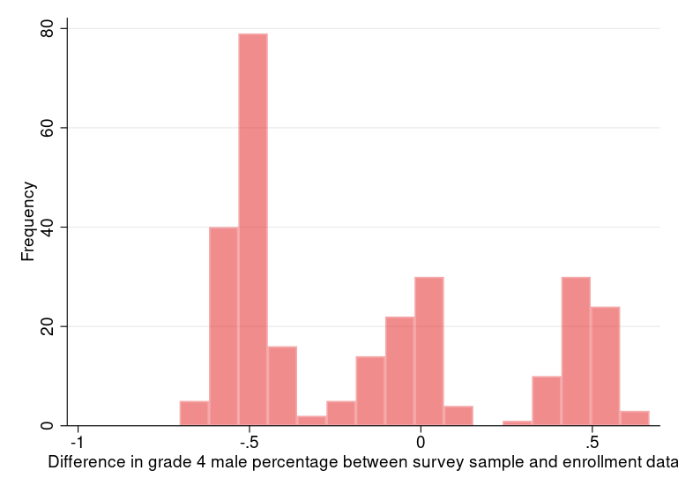
Difference in Percent of Students by Sex between Survey and Enrollment: Elementary 15-16

Slide 23
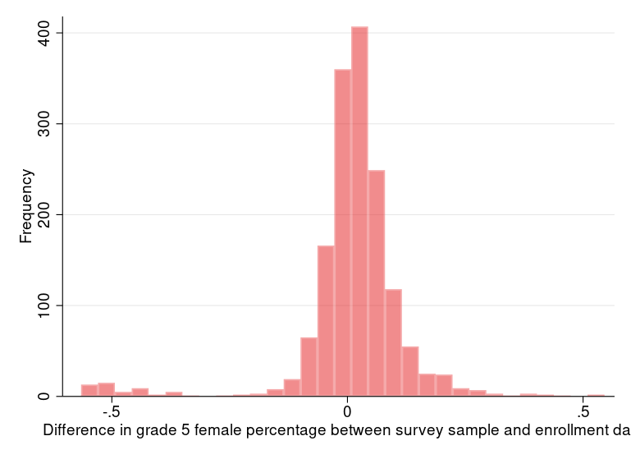
Difference in Percent of Students by Sex between Survey and Enrollment: Elementary 15-16

Slide 24
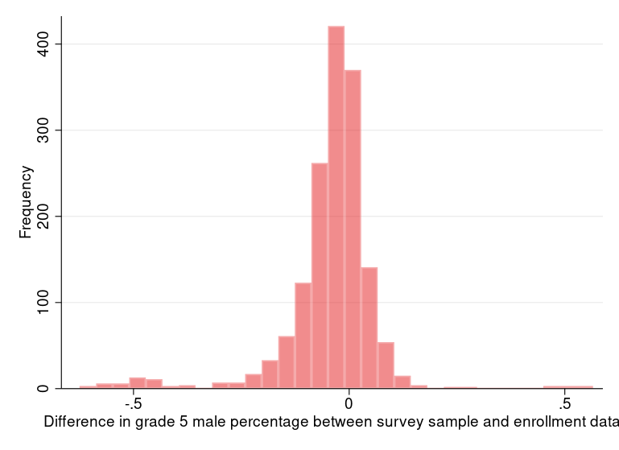
Difference in Percent of Students by Sex between Survey and Enrollment: Elementary 15-16

Slide 25
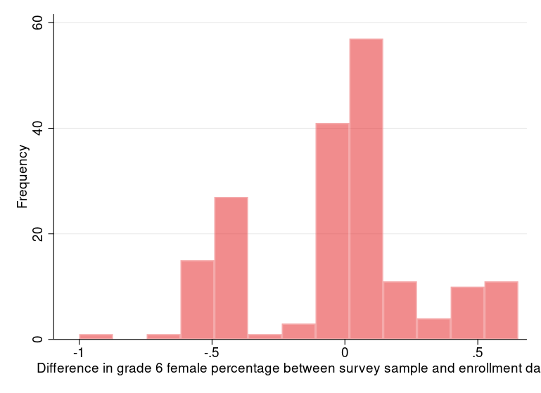
Difference in Percent of Students by Sex between Survey and Enrollment: Elementary 15-16

Slide 26
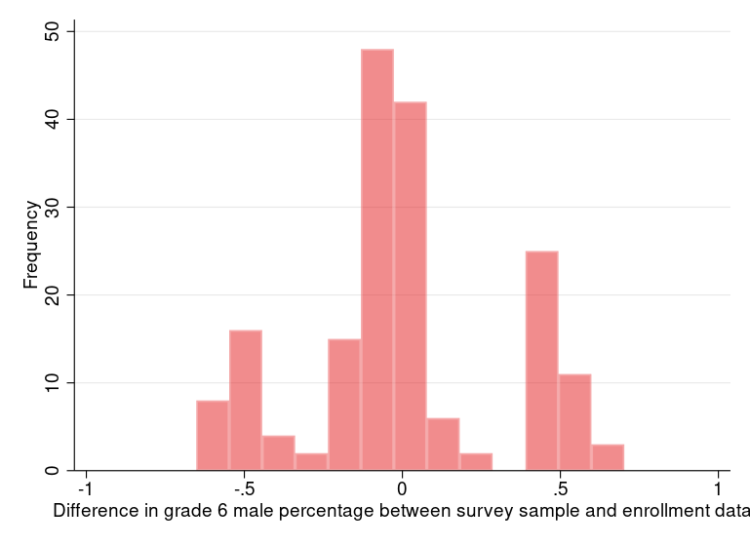
Difference in Percent of Students by Sex between Survey and Enrollment: Elementary 15-16

Slide 27
Elementary Diagnostics Ctd.
You get the idea…
Graphs for subsequent years are also available but omitted to save space here

Slide 28
Secondary Datasets Diagnostics
Response rates for each grade
Difference in percentage of students by sex between survey sample and enrollment sample
Difference in percentage of students by race/ethnicity between survey sample and enrollment sample

Slide 29
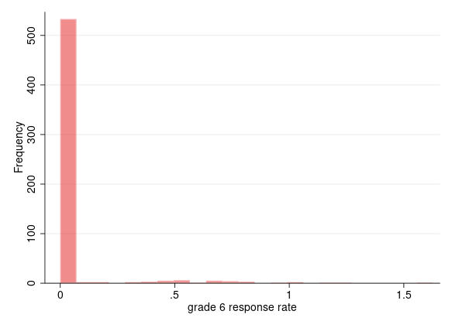
Secondary 14-15 Response Rates

Slide 30
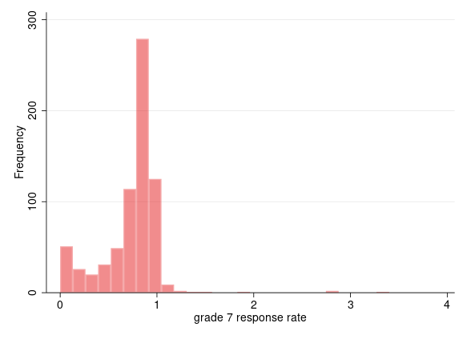
Secondary 14-15 Response Rates

Slide 31
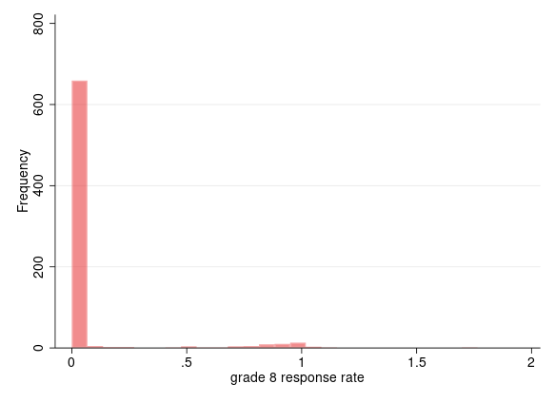
Secondary 14-15 Response Rates

Slide 32
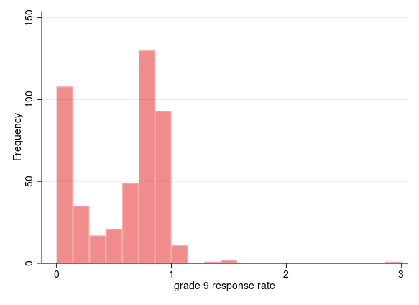
Secondary 14-15 Response Rates

Slide 33
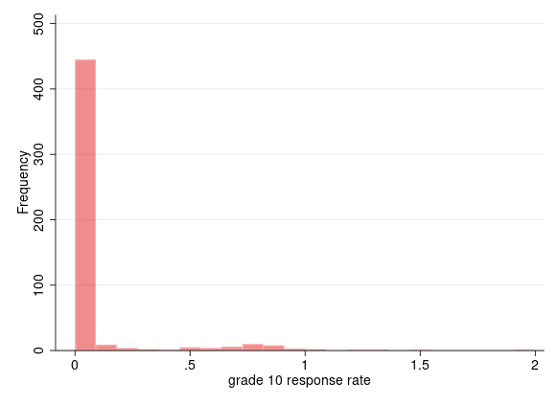
Secondary 14-15 Response Rates

Slide 34
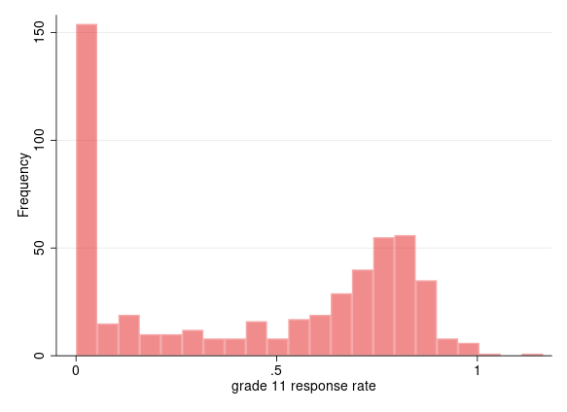
Secondary 14-15 Response Rates

Slide 35
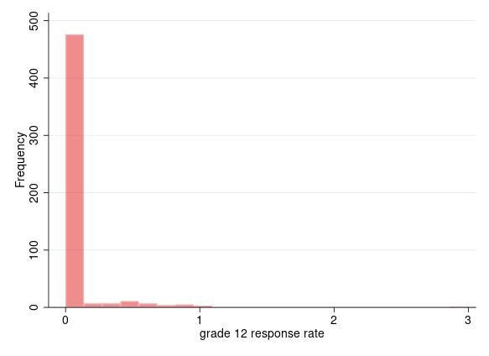
Secondary 14-15 Response Rates

Slide 36
An Example
Response rate for grade 7 is pretty high, we will look at diagnostics for grade 7 as an example
Again, graphs for other grades are available but omitted to reduce clutter

Slide 37
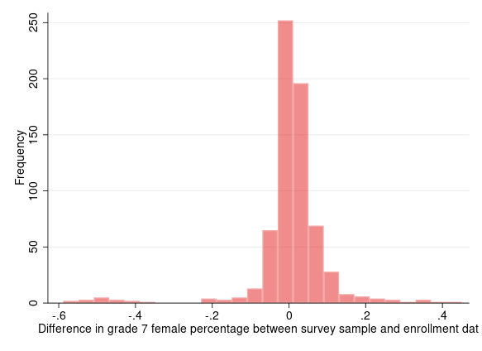
Secondary 14-15 Grade 7 Diagnostics
Difference in percentage of female students

Slide 38
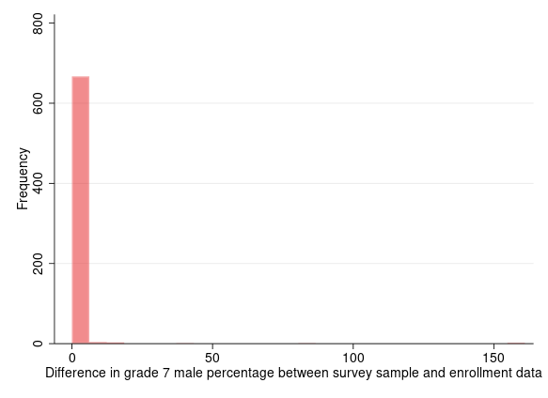
Secondary 14-15 Grade 7 Diagnostics
Difference in percentage of male students

Slide 39
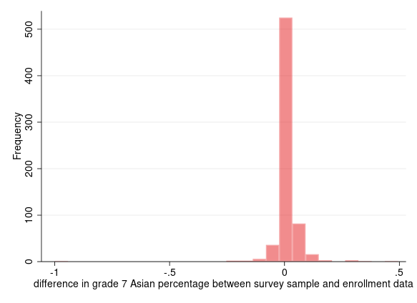
Secondary 14-15 Grade 7 Diagnostics
Percentage difference of Asians

Slide 40
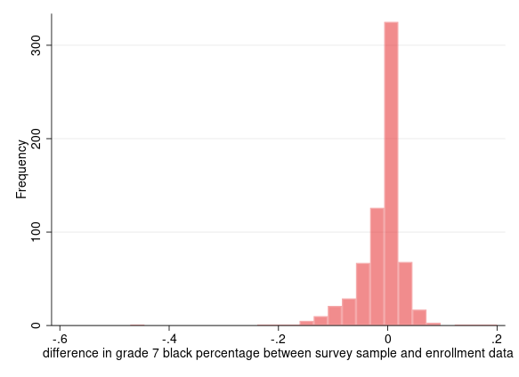
Secondary 14-15 Grade 7 Diagnostics
Percentage difference of blacks

Slide 41
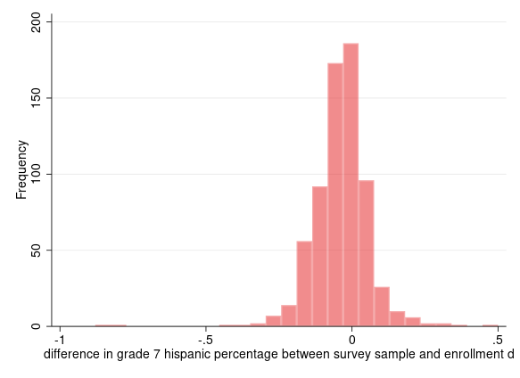
Secondary 14-15 Grade 7 Diagnostics
Percentage difference of Hispanics

Slide 42
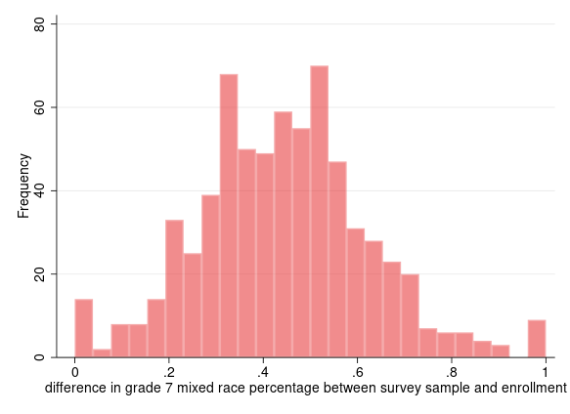
Secondary 14-15 Grade 7 Diagnostics
Percentage difference of mixed race

Slide 43
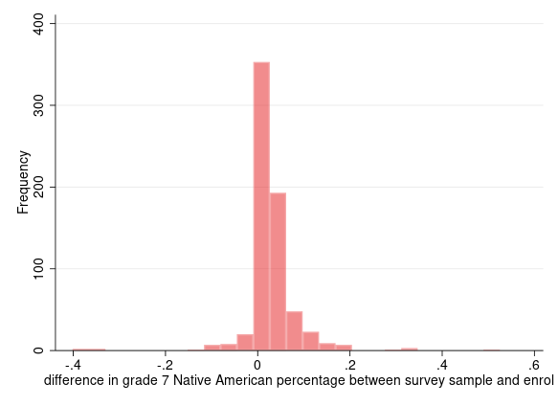
Secondary 14-15 Grade 7 Diagnostics
Percentage difference of Native Americans

Slide 44
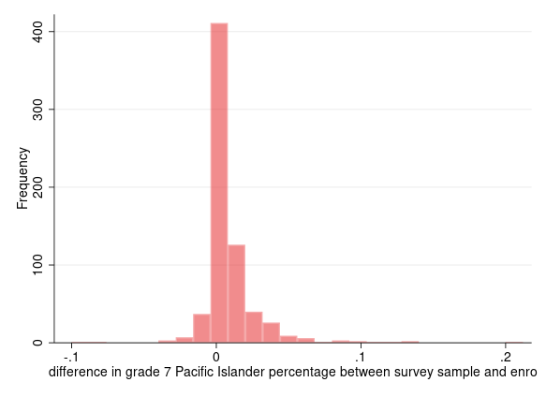
Secondary 14-15 Grade 7 Diagnostics
Percentage Difference of Pacific Islanders

Slide 45
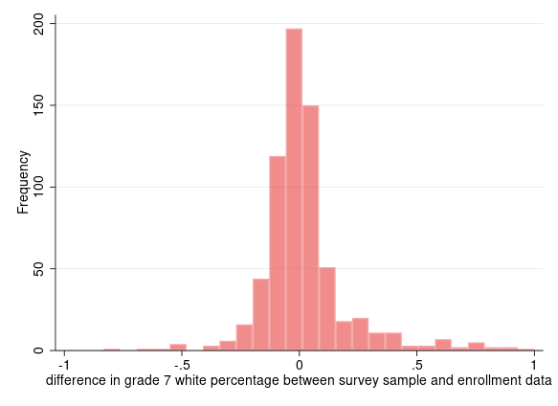
Secondary 14-15 Grade 7 Diagnostics
Percentage Difference of whites

Slide 46
Parent Survey Diagnostics
Example: 18-19, has more observations
Distribution of diagnostics look roughly the same for other years
The parent survey is a “household” survey, meaning one observation per household. This enables response rate calculations using enrollment data

Slide 47
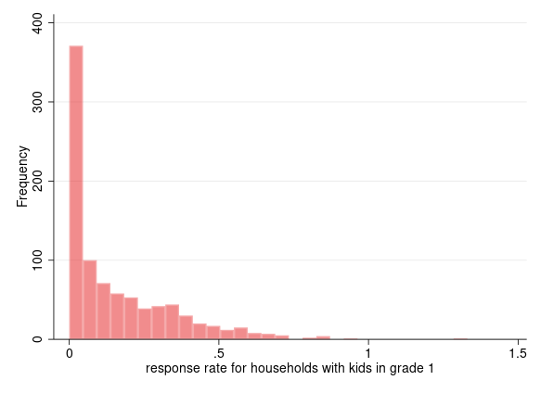
Parent 18-19 Response Rates

Slide 48
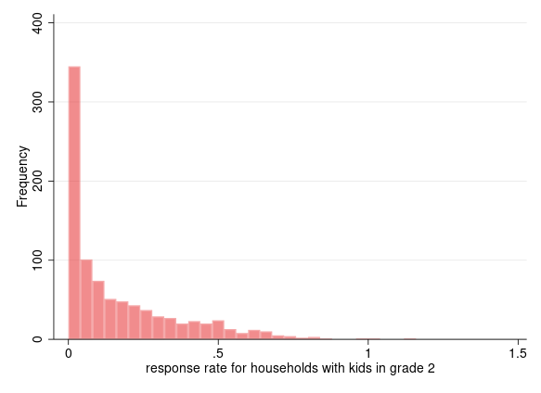
Parent 18-19 Response Rates

Slide 49
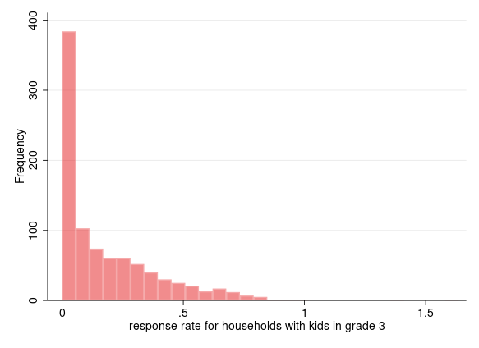
Parent 18-19 Response Rates

Slide 50
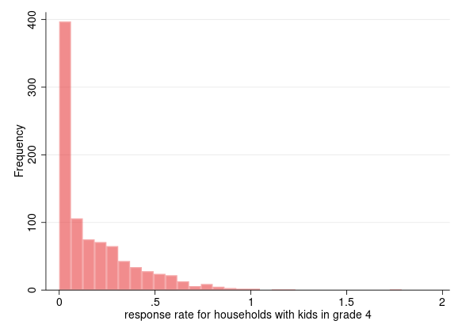
Parent 18-19 Response Rates

Slide 51
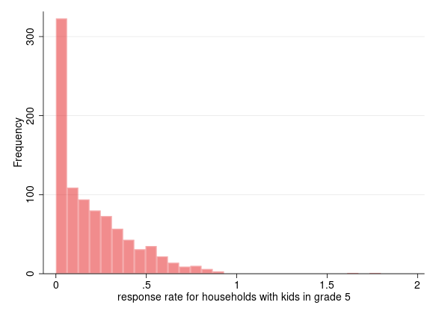
Parent 18-19 Response Rates

Slide 52
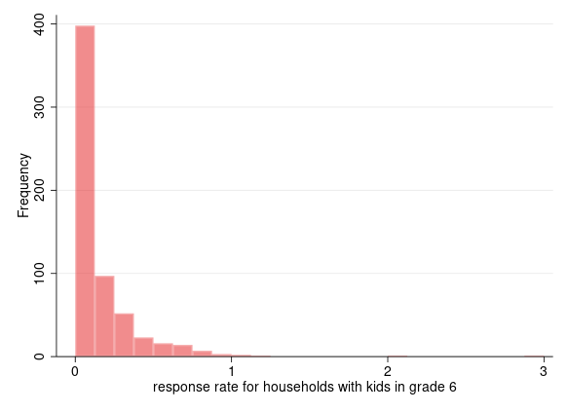
Parent 18-19 Response Rates

Slide 53
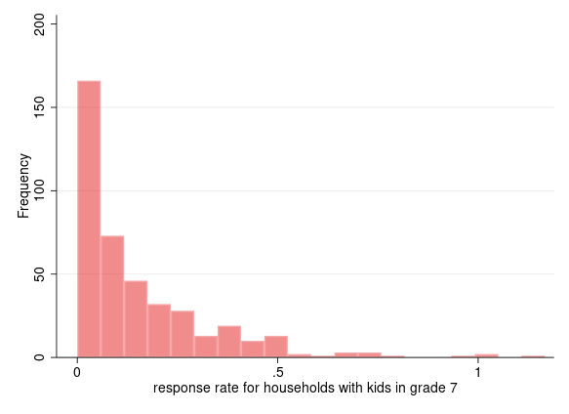
Parent 18-19 Response Rates

Slide 54
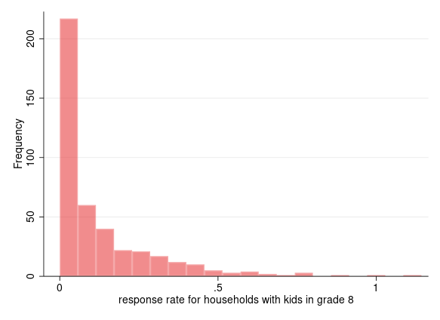
Parent 18-19 Response Rates

Slide 55
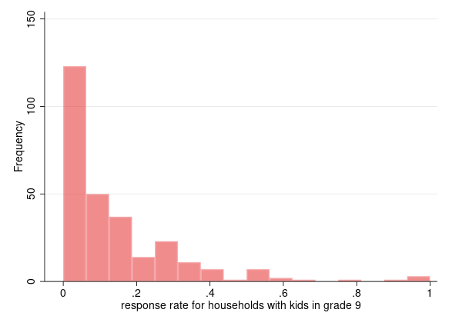
Parent 18-19 Response Rates

Slide 56
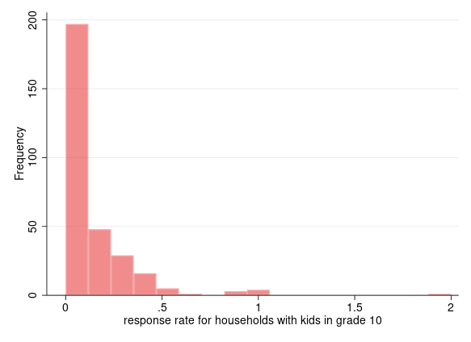
Parent 18-19 Response Rates

Slide 57

Parent 18-19 Response Rates

Slide 58

Parent 18-19 Response Rates

Slide 59
Thank you!
California Department of Education
Jonathan Isler
Ryan Fuller
California Community Colleges Chancellor’s Office
Gary Adams
Todd Hoig
California State University Chancellor’s Office
Ed Sullivan
Matthew Case
Note: The research reported here was supported by the Institute of Education Sciences, U.S. Department of Education, through Grant R305H150073 to the Regents of the University of California. The opinions expressed are those of the authors and do not represent views of the Institute or the U.S. Department of Education, or of the agencies providing data.

